Slide 1
ProxyClient Webfiltering /
BCWF Decoupling - SG 5.5
Andrew Kiggins
September 1, 2009

Slide 2
Problem statement
The Proxy Client Webfiltering policy is not granular enough
Customers want the capability to set policy by user and group
Improve installation success rate (Explicit Proxy Traversal)
Large customers find Location Awareness difficult for complex/large networks

Slide 3
Feature overview –
Operational
  Finer control over PxC WebfilteringPolicy
  Rules are based on Windows Users and Groups
Technical
  Introduces new XML blocks for user/group specific rules
  New parser engine for better performance
  Unloads when not configured
    Reduced footprint
    Reduced processing

Slide 4
Functional Overview
Configuration still downloaded from Client Manager to ProxyClient
  Transferred in XML (good for validating the policy)
    Encoded in-flight
  Encrypted on the endpoint at all times
Policy is still evaluated on the ProxyClient
  New engine
Ratings Service is always consulted (like previous versions)
  Connectivity is required to the Service Point

Slide 5
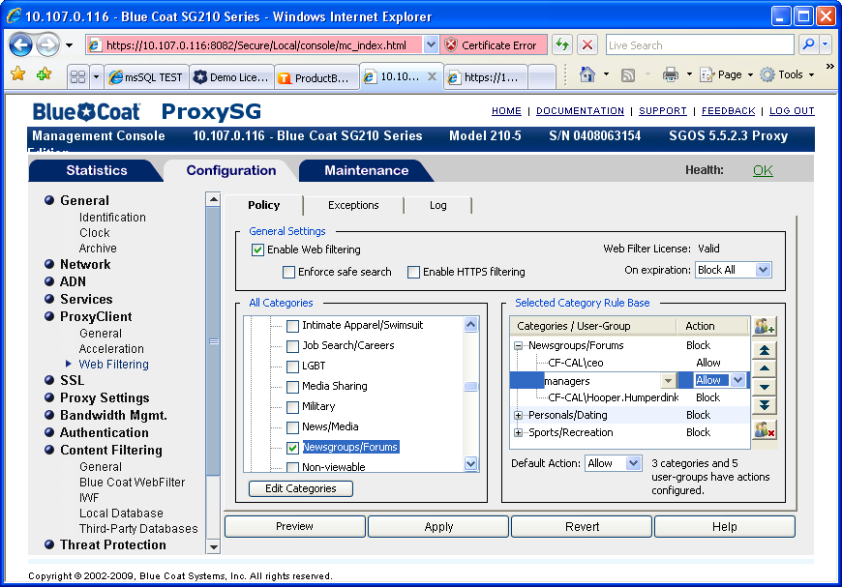
MC UI interface
Add a new user group rule
Selecting the rule highlights the category
Promote or demote rules
Delete a group or user rule
Default action

Slide 6
Policy Evaluation
The action associated with the First Match is executed
  if a user/group rule is defined it will take precedence over the category rule
  if a category rule matches it will take precedence over the default rule
  if the Ratings Service is unreachable the unavailable category is always used
Some URLs are associated with multiple categories
  from the Ratings Service
  from Custom Categories (whitelists/blacklists)
  Beware regional variation

Slide 7
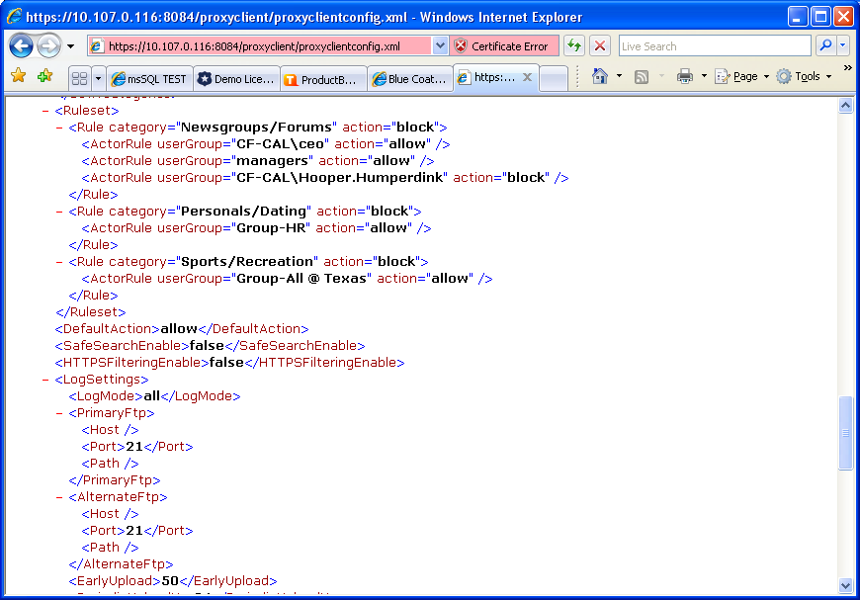
ProxyClientConfig.xml changes

Slide 8
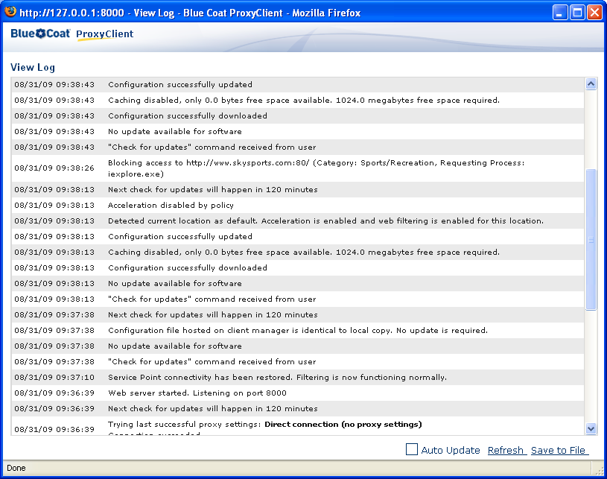
PxC side Event Log

Slide 9
ProxyClient Access Log
Username (cs-username) is always added to the Client Access Log when a webfiltering event takes place.

Slide 10
Upgrade issues – 1 of 2
To use the new user/group policy rules the SG version and PxC version must be synchronized, as earlier versions do not recognized the usergroup attributes
  SG 5.5.x or better
  PxC 3.2.x or better
Old versions will still work as they do currently. i.e policies are only category based.

Slide 11
Upgrade/downgrade issues – 2 of 2
Possible problems may appear due to some errors in the 5.3.1
  Catmap 7 mismatch
    General information https://intranet.bluecoat.com/sales/2009-url-category-update?RELOADED=1
    ProxyClient specific information https://intranet.bluecoat.com/doc/10832
SG rev/PxC rev | 5.3.x | 5.3.2 | 5.3.3/5.4.x
3.1.2 or earlier | Possible mismatch | OK | Possible mismatch
3.1.3 or later | Possible mismatch | OK | OK

Slide 12
Known issues
Whitelists/blacklists and access to the ServicePoint
  If the Ratings Service not reachable all URLs will resolve to the unavailable category (e.g. not to Custom categories)
A user with appropriate privileges could create a local user with the same name as a domain user to subvert the configured policy.

Slide 13
BCWF Decoupling
No need to download the entire BCWF database
  PxC only requires the list of categories
  Fewer clicks, faster config

Slide 14
Bells & Whistles
Explicit Proxy Traversal
  WebPulse requests, Client Manager communications
  Settings must be configured through IE
    Configuration via Explicit, WPAD or PAC file
  Supports authentication methods which do not prompt the user
Improved Hot-spot handling
  More scenarios are handled

Slide 15
SWG auto-detection (transparent location awareness)
Detects inline SG providing Content Filtering capabilities and disables ProxyClient Webfiltering conditionally
  Needs a few lines of CPL on each inline SG
define action i_am_filtering
set (response.x_header.X-BCWF-License, "<VendorID>");
end
<proxy>
url.host="sp.cwfservice.net" action.i_am_filtering(yes)

Slide 16

Questions and Answers

